Slide 1
Finding Service Boundaries
In distributed systems
Notes:
This is FInding Service Boundaries in Distributed Systems, if you are in the wrong place feel free to find hang out participate in the discussion or find the correct place where you are supposed to be.

Slide 2
“Every business is a software business”
Notes:
In most, if not all businesses these days, software has become essential. I doubt you can think of many successful businesses that don’t need to keep track of customers, or accept payments. Software facilitates many of our daily activities. The internet has become an essential utility much like electricity and water in modern society.

Slide 3
Who am I?
Notes:
Who am I, I’m an engineer, a technology enthusiast, and I’ve been doing some kind of programming since I was child. I like to think the first thing I ever programmed was a VCR setting it to record a TV station at a certain time, since then I’ve graduated to designing and building complex software systems. I’ve been a professional software engineer for around 17 years, but have always had a passion for technology and computing.
Today I work for Particular software, a company staffed with dozens of engineers focused on a singular goal, to make building complex distributed systems simple. For the next few minutes we will look at one of challenging aspects of building complex software systems, Finding Service boundaries.

Slide 4
What to expect
Notes:
So what should you expect?

Slide 5
What to expect
Interactivity, feel free to speak up
Terminology
Technique
Demo
Share resources
Notes:
This is a quick introduction to one aspect of Distributed Systems, service boundaries
There are a few points at which I’ll ask you to share your thoughts or ideas around some of these topics as this is intended to be a discussion.
We’ll cover a few terms
I’ll show you a simple technique
I’ll do a short demonstration of how the Particular platform can assist you in building distributed systems in .NET
I’ll then share additional resources on the topic of service boundaries, and other topics

Slide 6
What is a distributed system?
Notes:
What is a distributed system? Does anyone have a definition that they would like to share?
[Pause allow the audience to present some ideas]

Slide 7
Distributed Systems
Distributed computing is a field of computer science that studies distributed systems, defined as computer systems whose inter-communicating components are located on different networked computers.
The components of a distributed system communicate and coordinate their actions by passing messages to one another in order to achieve a common goal.
https://en.m.wikipedia.org/wiki/Distributed_computing
Notes:
This text from Wikipedia I believe sums it up pretty well.
“Distributed computing is a field of computer science that studies distributed systems, defined as computer systems whose inter-communicating components are located on different networked computers.
The components of a distributed system communicate and coordinate their actions by passing messages to one another in order to achieve a common goal.”
So we can see that distributed systems are are made up of components that reside in different network computers, and that they typically communicate with each other by passing messages to one another, in order to achieve a common goal.
Think for a moment, about why? What is the purpose of having distributed components across various machines in a network? What benefits do you get from this? And what are the trade offs?
[Pause for responses]

Slide 8
Why build distributed systems
Partitioning / Modularity
Scalability
Reliability
Maintainability
Fault tolerance
Security
Consistency
Notes:
Some reasons to build distributed systems
Partitioning, its really difficult for a single application to handle all the needs of a single business, and for a single team to have all the knowledge required to maintain a single system (like a monolith application) .
Once the system is physically partitioned into separate deployable applications then those applications can be made scalable increasing reliability, and fault tolerance.
Furthermore it becomes possible to consider the security requirements of each application and or component independent of the entire system
Consistency becomes a smaller weight concern as well as only the information within a specific application or service has the requirement of maintaining consistency

Slide 9
What is a service?
Notes:
Now that we have some idea about what a Distributed System is let me say that Distributed systems are not just made up of components on different machines, but there is a higher level logical separation. That separation is known as a service.

Slide 10
Service
A technical authority for a given business capability.
All data and rules reside within the service.
Notes:
A service is the technical authority for a given business capability. Ok so what does that mean. This means that each service is autonomous and encapsulates the functionality and data related to facilitating the required actions of a specific business capability.
I’ll show a few examples of this in a minute.
Also pay attention to that second line, “All data and rules reside with the service”

Slide 11
What is a service boundary?
Notes:
Now that we have some idea of what a service is, what do you think is a service boundary?
[Pause for response]

Slide 12
Service Boundary
A Service Boundary refers to the scope and limits of a service, separating the functionality and data contained within the service from that which is external to it.
Each service will contain its own independent data and functionality. This information is not shared with other services.
Notes:
The scope and limits of a service, separating the functionality and data are contained within the service from that which is external to it.
Each service will contain its own independent data and functionality. This information is not shared with other services.

Slide 13
How to find a Service Boundary?
Notes:
Ok, all the terms have been somewhat identified, so how do we actually find the service boundaries.
This is probably easiest explained through a familiar example. Retail

Slide 14
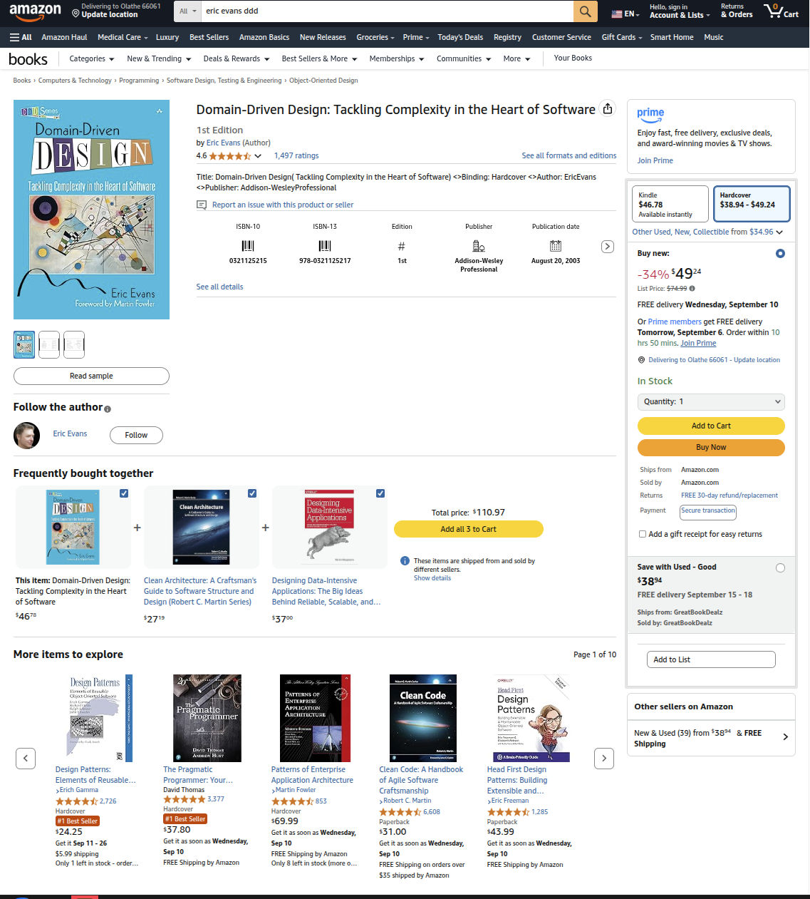
What data do you see on this page?
Name
Product details
Price
Inventory availability
Reviews
Recommendations
Shipping estimates/options
How many services are involved to render this page?
Notes:
I’m sure that everyone has shopped on Amazon before, this image is from a few days ago, and I believe it does a pretty good job of illustrating the concepts that we’ve discussed so far, so let's see if we can find the boundaries together.
Let’s first start by looking at the data.
What types of data do you see on the screen? Are there any pieces of data that you feel like would belong in the same service?
[PAUSE for Discussion]
[Click to show next segment]
Let’s talk services
[Click to show next segments]
How many people think there should only be one service involved in rendering this page?
(Please raise your hands)
How many people think that there are multiple services involved in rendering this page?
(Please Raise your hands)
If you thought one, why?
[PAUSE]
If you thought more than one why?
[PAUSE]

Slide 15
Service - a neat trick
A technical authority for a given business capability.
All data and rules reside within the service.
Notes:
We previously said that a Service contains its own data and rules. One really simple way to verify if two pieces of data belong within the same service or not is if there is a rule (typically in the form of a requirement) that can be expressed that affects the validity of one or the other.
For example, is there such a rule that the name of the product affects the price of the product. A silly example might be “All products whose name starts with D must not be priced higher than $10”. That is the type of question that you can ask a domain expert to try to find the boundaries or rules of the system. Another counter example of this might be does the shipping address of the order affect the price charged to deliver the product? Does it affect the estimated date of delivery? What other factors may play a role in the shipping fee? Are they a loyalty member?
Another example, is there a requirement that products with low review scores are not eligible for express delivery? (this would be something that you’d need to discuss with the stakeholders)
These rules help to ensure data consistency, and that rules are used to enforce data integrity, rather than some arbitrary imagined rules decided by developers. When you have clear separation of data in their representative services then consistency across a distributed system becomes much more simple to deal with as only the limited number of rules are required to be enforced.
The technique used here is known as anti-requirements and is often a simple way to validate if the data that you are attempting to keep consistent really needs to be.

Slide 16
Demo
Notes:
Ok, I want to show you a quick demo of our product, highlighting the simplicity of communicating between services

Slide 17
Distributed Systems
Distributed computing is a field of computer science that studies distributed systems, defined as computer systems whose inter-communicating components are located on different networked computers.
The components of a distributed system communicate and coordinate their actions by PASSING MESSAGES to one another in order to achieve a common goal.
https://en.m.wikipedia.org/wiki/Distributed_computing
Notes:
Before we get to the demo, I wanted to highlight this important part of the text I mentioned at the beginning of this presentation.
“The components of a distributed system communicate and coordinate their actions by passing messages to one another in order to achieve a common goal.”
(You will see this in the demo)

Slide 18
Demo - Yes really this time

Slide 19
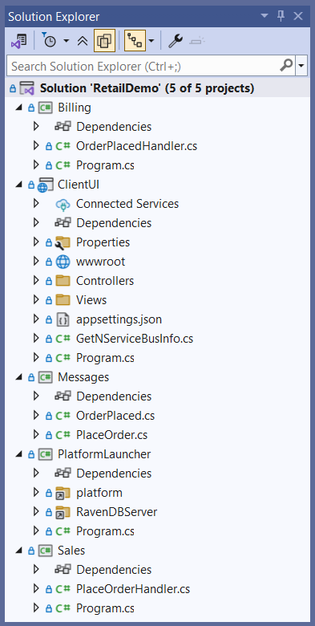
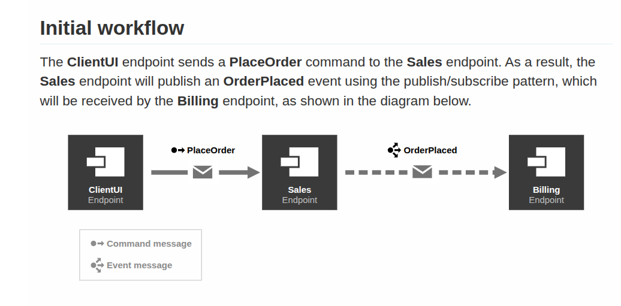
Workflow
Notes:
The demo is really quick, but I’ll explain what’s happened with a few short slides

Slide 20
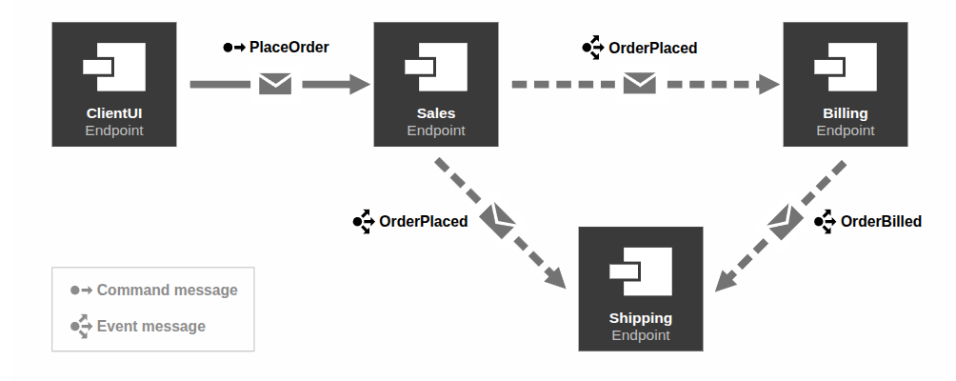
When to ship the order

Slide 21

Additional Resources
Slides, longer versions of this talk and other resources can be found by visiting this link

